Slide 1
PRESENTATION TITLE
Automating Home Loan Approval
with Machine Learning
September 11, 2023

Slide 2
TEXT LAYOUT 1
Agenda
Data Science Lifecycle​
Project Overview​
Data
Analysis
Modeling
Model Evaluation
Recommendations

Slide 3
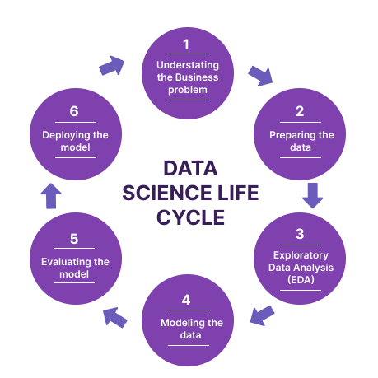
TEXT LAYOUT 1
Data Science Lifecycle

Slide 4
TEXT LAYOUT 1
Project Overview
Business Problem: The current manual home loan application process requires 2-3 days for applicant notifications.
Business Objective: The aim is to reduce notification time to seconds, utilizing machine learning on historical data for instant loan status predictions.
Hypothesis: Historical data-driven machine learning can significantly decrease the time applicants wait for loan status notifications.

Slide 5


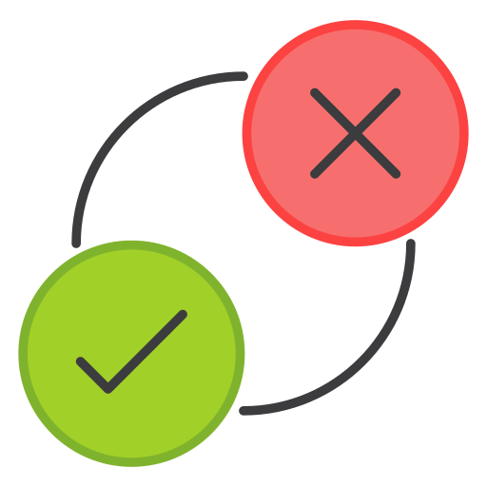


TEXT LAYOUT 1
Process Overview / Solution
Applicants can apply from any device, providing personal details as asked. Once submitted, the machine learning model, trained on historical data, instantly predicts and displays the outcome (Accepted or Declined) on the same device within seconds.

Slide 6
TEXT LAYOUT 1
Data
Data Contains 981 records and 13 columns
The number of categorical columns – 5
The number of numerical columns – 8
Target/Loan Status – Y(422) and N(192)

Slide 7
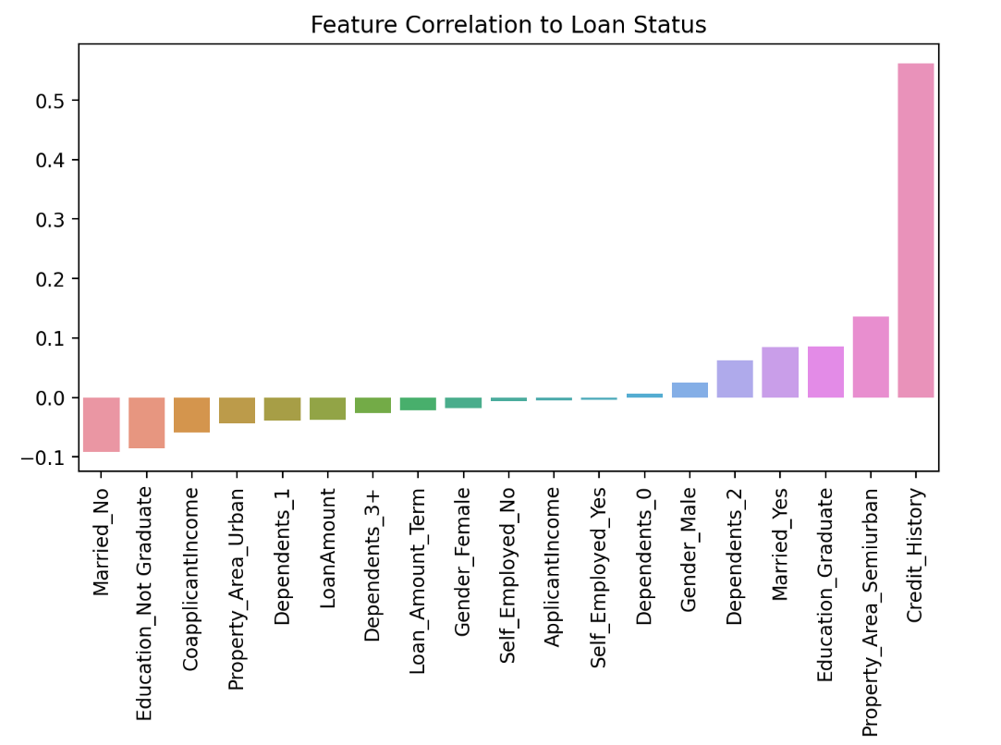
TEXT LAYOUT 1
Analysis

Slide 8
TEXT LAYOUT 1
Modeling
AutoML and Bespoke ML models were used.
AutoML outperforms Random Forest by 1.7% but not a significant difference.
Both models have similar precision.

Slide 9
TEXT LAYOUT 1
Model Evaluation
AutoML Accuracy:79%
Bespoke ML Accuracy: 77%
Accuracy in model prediction is a measure of how many of the total predictions made by a machine learning model are correct.

Slide 10
TEXT LAYOUT 1
Recommendations
Start with AutoML: Begin model development with AutoML to save time in predicting applicants who might default.
Consider Bespoke ML: Explore Bespoke ML for fine-tuning and optimizing the model once the initial model is in place.
Prioritize Data Quality: Invest in data quality and feature engineering to ensure accurate predictions.
Regular Monitoring: Continuously monitor and retrain the model to adapt to changing borrower behaviours and maintain accuracy.

